Slide 1

Introduction to Generics Programming and Collections

Slide 2

Java Generic
Need Of Generic
  The need for generic types stems mainly from the implementation and use of collections, like the ones in the Java Collections framework.
  Programmers often want to specify that a collection contains elements of a certain type, such as a list of integral values or a list of strings
  The Collections framework in non-generic Java did not offer any homogenous collections of elements of the same type
  All collections were holding Object references and for that reason they were potentially heterogeneous, that is, a mix of objects of different types.
  The non-generic collections accepted objects of arbitrary type for insertion into the collection and returned an Object reference when an element was retrieved from the collection
  Due to this result would be ClassCastException into code

Slide 3
Java Generic
Type unsafe code
List intList = new ArrayList();
//should store java.lang.Integer objects only
intList.add(new Integer(1));
//OK
intList.add("2");
//Wrong, but not detected by compiler or runtime system
Integer number0 = (Integer)intList.get(0);
//OK
Integer number1 = (Integer)intList.get(1);
//throws ClassCastException

Slide 4
Generic Programming
Benefits of Generic Programming
  The need for generic types stems mainly from the implementation and use of collections, like the ones in the Java Collections framework.
  Programmers often want to specify that a collection contains elements of a certain type, such as a list of integral values or a list of strings
  The Collections framework in non-generic Java did not offer any homogenous collections of elements of the same type
  All collections were holding Object references and for that reason they were potentially heterogeneous, that is, a mix of objects of different types.
  The non-generic collections accepted objects of arbitrary type for insertion into the collection and returned an Object reference when an element was retrieved from the collection
  Due to this result would be ClassCastException into code

Slide 5
Generic Programming
Benefits of Generic Programming
The use of the Java generics language features were initially motivated by the need to have a mechanism for efficient implementation of homogenous collections.
Type safety :- We can hold only a single type of objects in generics. It doesn’t allow to store other objects
Type casting is not required: There is no need to typecast the object
Compile-Time Checking: It is checked at compile time so problem will not occur at runtime. The good programming strategy says it is far better to handle the problem at compile time than runtime
.

Slide 6
Generic Programming
Syntax
public class OnRent<E>{
private E[] list;
private int size;
... //stuff
public boolean takeBackFromRent(E o) {
list[size++] = o;
return true;
}
public E giveOnRent(int i) {
return <E>list[i];
} //etc...
}

Slide 7
Generic Programming
calss Car{
int carId,carRent;
}
OnRent<Car> carOnRentRef;=new OnRent<Car>();
public class OnRent<Car>{
private Car[] list; private int size;
public boolean takeBackFromRent(Car o) {
list[size++] = o;
return true;
}
public Car giveOnRent(int i) {
return <Car>list[i];
}
}

Slide 8

Collections Framework
The Collections Framework is made up of a set of interfaces for working with groups of objects.
    The different interfaces describe the different types of groups
    Collection framework is very helpful to developers by providing all standard data structures algorithms to let the developer concentrate more on functionality rather than the lower level details
    Reduced effort for code maintenance by using collection classes shipped with JDK
    Operations like insertation , deleteation , searching , sorting , iteartion are allowed with collection API classes, also support in memory cahcing

Slide 9
Collections Framework
Interfaces in Collection API
  Collection
    Collection<E> interface is the root of the collection hierarchy.A collection represents a group of objects known as its elements.
  List
    List<E>is an ordered and unsorted collection and can contain duplicate elements.You can access any element from it’s index. List is more like array with dynamic length
  Set
    Set<E>is a collection that cannot contain duplicate elements. This interface models the mathematical set abstraction and is used to represent sets, such as the deck of cards.
  Map
    Map<K,V>is an object that maps keys to values. A map cannot contain duplicate keys: Each key can map to at most one value

Slide 10
Collections Framework
Interfaces in Collection API
  Comparable<E>
    Comparable<E> interface is used to order the objects of user-defined class.It contains only one method named compareTo(Object).It provide only single sorting sequence i.e. you can sort the elements on based on single data member only
  Comparator<E>
    Comparator<E> interface is used to order the objects of user-defined class.It provides multiple sorting sequence i.e. you can sort the elements based on any data member
  SortedSet<E>
    SortedSet<E> interface is a subtype of the java.util.Set interface. It behaves like a normal set with the exception that the elements are sorted internally. This means that when you iterate the elements of a SortedSet the elements are returned in the sorted order

Slide 11
Collections Framework
List Classes and interfaces
Iterable
AbstractCollection
- - - - - >
Collection
AbstractList
- - - - - - - - - - >
List
ArrayList
LinkedList
Vector
Stack
extends
- - – - - – ->
implements

Slide 12
ArrayList Constructor's
ArrayList( )
ArrayList(Collection c)
ArrayList(int capacity)

Slide 13
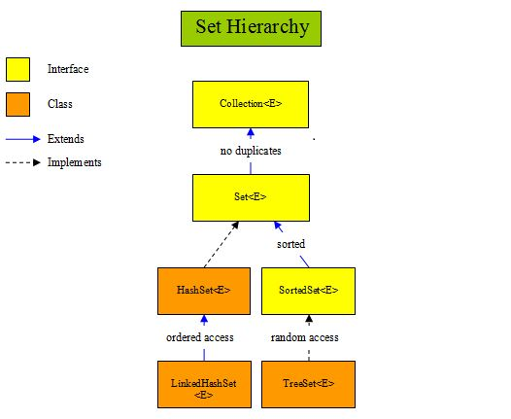
Set Classes and Interfaces

Slide 14
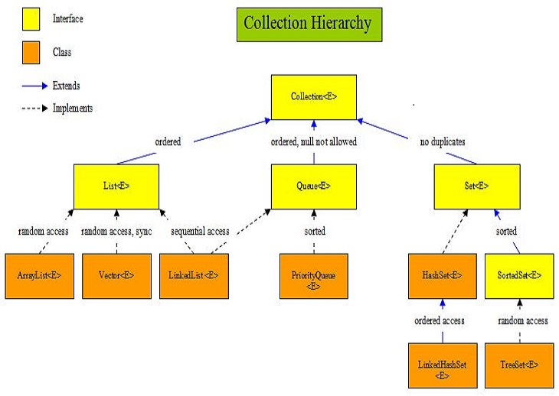
Collection Hierarchy Diagram

Slide 15
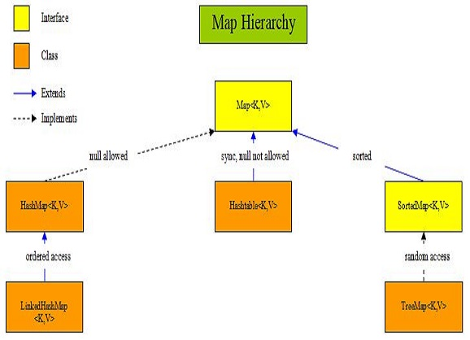
Map Classes and Interfaces

Slide 16
Collections Framework
ArrayList<E>
  ArrayList supports dynamic arrays that can grow as needed. In Java, standard arrays are of a fixed length.
  ArrayList is a variable-length array of object references
  Array lists are created with an initial size 10
  When this size is exceeded, the collection is automatically enlarged. When objects are removed, the array may be shrunk.
  Because ArryList is backby array which stored element sequentially, best sutable in project requirment where lots of iteration is required on collection, result will be fastest iteration time
  Not Sutable for frequent insert and removal operation
Notes:
http://java67.blogspot.in/2012/12/difference-between-arraylist-vs-LinkedList-java.html

Slide 17
Collections Framework
LinkedList<E>
  Java LinkedList class uses doubly linked list to store the elements. It extends the AbstractList class and implements List and Deque interfaces
  Java LinkedList class maintains insertion order.
  Because LinkedList is a implemenataion of doubly linked list best sutable in project requirment where lots of insertion and removel operation needs to be performed
  LinkedList elements store in random location because of that iterartion
  operation is slow comparatively ArrayList
  addFirst() and addLast() methods are extra available

Slide 18
Collections Framework
Vector<E>
  Vector implements a dynamic array. It is similar to ArrayList
  Vector is synchronized, all methods are synchronized
  Because Vector is synchronized best sutable in project requirment where
  Multi threading is use, it ensure data concistancy
  Old collection classes are also called as legacy class

Slide 19
Collections Framework
Stack<E>
  Stack class derived from Vector
  It is implemantation of LIFO principle
  Because Stack support LIFO principle best sutable in project requirment where pop , push , peek operation are required
  pop() , push() , peek() methods are available

Slide 20

Collections Framework
Sorting operation on List collection
  All List type classes by default support order and unsorted collection
  Some time collection needs to be in sorted way
  Collections.sort() method

Slide 21
Iterator Interface
The iterator() method of the Collection interface returns and Iterator.
An Iterator is similar to the Enumeration interface.
Iterators differ from enumerations in two ways:
1 Iterators allow the caller to remove elements from the underlying collection during the iteration with well-defined semantics.
2 Method names have been improved.

Slide 22
Iterator Interface
Sr No | Method Signature | Methods with Description
1 | boolean hasNext( ) | Returns true if there are more elements. Otherwise, returns false.
2 | Object next( ) | Returns the next element. Throws NoSuchElementException if there is not a next element.
3 | void remove( ) | Removes the current element. Throws IllegalStateException if an attempt is made to call remove( ) that is not preceded by a call to next( ).

Slide 23
ListIterator Interface
ListIterator Interface is used to traverse the element in backward and forward direction.
Commonly used methods of ListIterator Interface:
public boolean hasNext();
public Object next();
public boolean hasPrevious();
public Object previous();

Slide 24
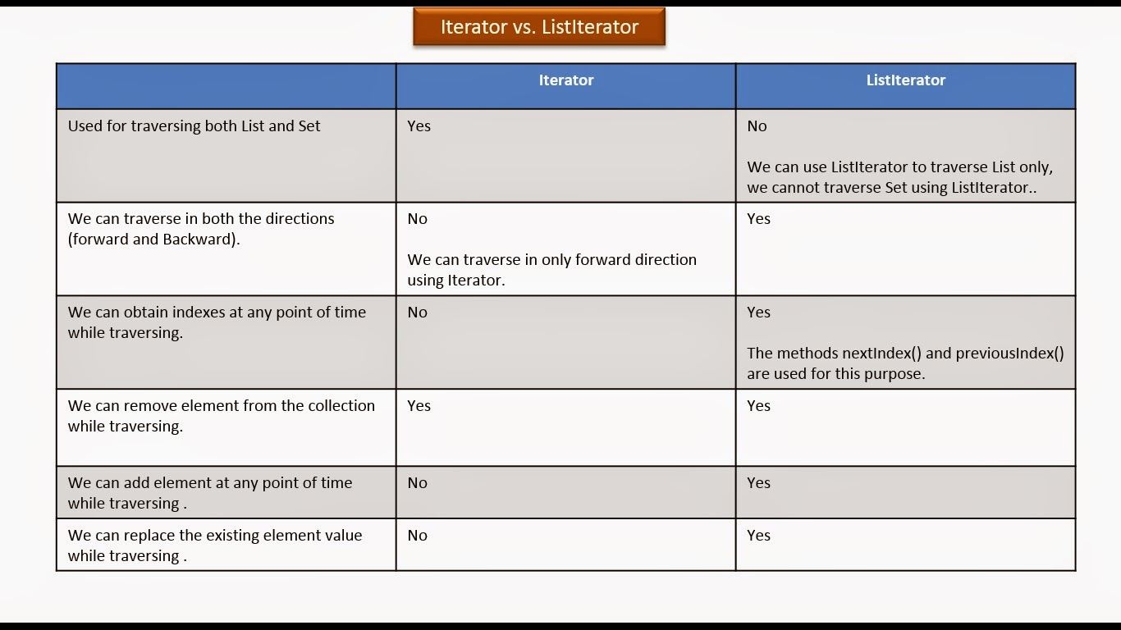

Slide 25
Iterators for Sets
A set has a method iterator to create an iterator over the elements in the set
The iterator has the usual methods:
  boolean hasNext()
  Object next()
  void remove()

Slide 26
Typical set operations
Sometimes it is useful to compare sets:
  subset: S1 is a subset of S2 if S2 contains every element from S1.
Many times it is useful to combine sets in the following ways:
  union: S1 union S2 contains all elements that are in S1 or S2.
  intersection: S1 intersect S2 contains only the elements that are in both S1 and S2.
  difference: S1 difference S2 contains the elements that are in S1 that are not in S2.
How could we implement these operations using the methods in Java's Set interface?
Notes:
Testing if s2 is a subset of s1
s1.containsAll(s2)
Setting s1 to the union of s1 and s2
s1.addAll(s2)
Setting s1 to the intersection of s1 and s2
s1.retainAll(s2)
Setting s1 to the set difference of s1 and s2
s1.removeAll(s2)

Slide 27
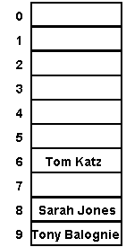
How does a HashSet work?
Every object has a reasonably-unique associated number called a hash code
  public int hashCode() in class Object
HashSet stores its elements in an array a such that a given element o is stored at index o.hashCode() % array.length
  any element in the set must be placed in one exact index of the array
  searching for this element later, we just have
  to check that one place to see if it's there (O(1))
    "Tom Katz".hashCode() % 10 == 6
    "Sarah Jones".hashCode() % 10 == 8
    "Tony Balognie".hashCode() % 10 == 9
you don't need to understand this...

Slide 28
Membership testing in HashSets
When testing whether a HashSet contains a given object:
  Java computes the hashCode for the given object
  looks in that index of the HashSet's internal array
    Java compares the given object with the object in the HashSet's array using equals; if they are equal, returns true
Hence, an object will be considered to be in the set only if both:
  It has the same hash code as an element in the set, and
  The equals comparison returns true
an object that is put into a HashSet works best if it has a public int hashCode()method defined
  String, Integer, Double, etc. have this already

Slide 29
Set practice problems
Modify our Sieve of Eratosthenes to return a Set of primes, instead of just printing them.
Given a List of elements or string of many words, determine if it contains any duplicates, using a Set. (You can use a Scanner to break up a String by words.)

Slide 30
Mapping between sets
Sometimes we want to create a mapping between elements of one set and another set
  example: map people to their phone numbers
    "Marty Stepp" --> "253-692-4540"
    "Jenny" --> "253-867-5309"
How would we do this with a list (or list(s))?
  A list doesn't map people to phone numbers; it maps ints from 0 .. size - 1 to objects
  Could we map some int to a person's name, and the same int to the person's phone number?
  How would we find a phone number, given the person's name? Is this a good solution?

Slide 31
A new collection: Map
Map: an unordered collection that associates a collection of element values with a set of keys so that elements they can be found very quickly (O(1)!)
  Each key can appear at most once (no duplicate keys)
  A key maps to at most one value
  the main operations:
    put(key, value)
    "Map this key to that value."
    get(key)
    "What value, if any, does this key map to?"
  maps are also called:
    hashes or hash tables
    dictionaries
    associative arrays

Slide 32
Java's Map interface
public interface Map {
Object put(Object key, Object value);
Object get(Object key);
Object remove(Object key);
boolean containsKey(Object key);
boolean containsValue(Object value);
int size();
boolean isEmpty();
void putAll(Map map);
void clear();
Set keySet();
Collection values();
}
Basic ops
Bulk ops
Collection
views

Slide 33
Map implementations in Java
Map is an interface; you can't say new Map()
There are two implementations:
  java.util.HashMap is best for most purposes
  we won't use the other one: TreeMap
Preferred: Map m = new HashMap();
Not: HashMap m = new HashMap();

Slide 34
HashMap example
HashMap grades
HashMap grades = new HashMap();
grades.put("Martin", "A");
grades.put("Nelson", "F");
grades.put("Milhouse", "B");
// What grade did they get?
System.out.println(
grades.get("Nelson"));
System.out.println(
grades.get("Martin"));
grades.put("Nelson", "W");
grades.remove("Martin");
System.out.println(
grades.get("Nelson"));
System.out.println(
grades.get("Martin"));
HashMapEntry
HashMap
"Martin"
"A"
0
HashMapEntry
2
"Nelson"
"F"
HashMapEntry
5
"Milhouse"
"B"

Slide 35
Map example
public class Birthday {
public static void main(String[] args){
Map m = new HashMap();
m.put("Newton", new Integer(1642));
m.put("Darwin", new Integer(1809));
System.out.println(m);
}
}
Output:
{Darwin=1809, Newton=1642}

Slide 36
Some Map methods in detail
public Object get(Object key)
  returns the value at the specified key, or null if the key is not in the map (constant time)
public boolean containsKey(Object key)
  returns true if the map contains a mapping for the specified key (constant time)
public boolean containsValue(Object val)
  returns true if the map contains the specified object as a value
  this method is not constant-time O(1) ... why not?

Slide 37
Collection views
A map itself is not regarded as a collection
  Map does not implement Collection interface
  although, in theory, it could be seen as a collection of pairs, or a relation in discrete math terminology
Instead collection views of a map may be obtained
  Set of its keys
  Collection of its values (not a set... why?)

Slide 38
Iterators and Maps
Map interface has no iterator method; you can’t get an Iterator directly
must first call either
  keySet() returns a Set of all the keys in this Map
  values() returns a Collection of all the values in this Map
then call iterator() on the key set or values
  Examples:
  Iterator keyItr = grades.keySet().iterator();
  Iterator elementItr = grades.values().iterator();
  If you really want the keys or element values in a more familiar collection such as an ArrayList, use the ArrayList constructor that takes a Collection as its argument
  ArrayList elements = new ArrayList(grades.values());

Slide 39
Examining all elements
Usually iterate by getting the set of keys, and iterating over that
Set keys = m.keySet();
Iterator itr = keys.iterator();
while (itr.hasNext()) {
Object key = itr.next();
System.out.println(key + "=>" +
m.get(key));
}
Output:
Darwin => 1809
Newton => 1642

Slide 40
Map practice problems
Write code to invert a Map; that is, to make the values the keys and make the keys the values.
Map byName = new HashMap();
byName.put("Darwin", "748-2797");
byName.put("Newton", "748-9901");
Map byPhone = new HashMap();
// ... your code here!
System.out.println(byPhone);
Output:
{748-2797=Darwin, 748-9901=Newton}
Write a program to count words in a text file, using a hash map to store the number of occurrences of each word.

Slide 41
Difference between HashMap and Hashtable
Hashtable | HashMap
Hashtable class is synchronized. | HastMap is not synchronize.
Because of Thread-safe, Hashtable is slower than HashMap | HashMap works faster.
Neither key nor values can be null | Both key and values can be null
Order of table remain constant over time. | Does not guarantee that order of map remain constant over time.

Slide 42


Which class should I use?
You'll notice that collection classes all provide the same or similar functionality. The difference between the different classes is how the structure is implemented.
This generally has an impact on performance.
Use Vector
  Fast access to elements using index
  Optimized for storage space
  Not optimized for inserts and deletes
Use ArrayList
  Same as Vector except the methods are not synchronized. Better performance
Use linked list
  Fast inserts and deletes
  Stacks and Queues (accessing elements near the beginning or end)
  Not optimized for random access

Slide 43

Which class should I use?
Use Sets
  When you need a collection which does not allow duplicate entries
Use Maps
  Very Fast access to elements using keys
  Fast addition and removal of elements
  No duplicate keys allowed
When choosing a class, it is worthwhile to read the class's documentation in the Java API specification. There you will find notes about the implementation of the Collection class and within which contexts it is best to use.

Slide 44
Set Implementation Comparisons
 | HashSet | TreeSet | Linked HashSet
Storage Type | Hash Table | Red-Black Tree | Hash Table with a Linked List
Performance | Best performance | Slower than HashSet | Little costly than HashSet
Order of Iteration | No guarantee of order of iteration | Order based | Orders elements based on insertion

Slide 45
Collection classes in a Nutshell
Collection | Ordering | Random Access | Key-Value | Duplicate Elements | Null Element | Thread Safety
ArrayList | Yes | Yes | No | Yes | Yes | No
LinkedList | Yes | No | No | Yes | Yes | No
HashSet | No | No | No | No | Yes | No
TreeSet | Yes | No | No | No | No | No
HashMap | No | Yes | Yes | No | Yes | No
TreeMap | Yes | Yes | Yes | No | No | No

Slide 46
Collection classes in a Nutshell
Collection | Ordering | Random Access | Key-Value | Duplicate Elements | Null Element | Thread Safety
Vector | Yes | Yes | No | Yes | Yes | Yes
Hashtable | No | Yes | Yes | No | No | Yes
Properties | No | Yes | Yes | No | No | Yes
Stack | Yes | No | No | Yes | Yes | Yes
CopyOnWriteArrayList | Yes | Yes | No | Yes | Yes | Yes
ConcurrentHashMap | No | Yes | Yes | No | No | Yes
CopyOnWriteArraySet | No | No | No | No | Yes | Yes

Slide 47
Comparable and Comparators
You will have noted that some classes provide the ability to sort elements.
  How is this possible when the collection is supposed to be de-coupled from the data?
Java defines two ways of comparing objects:
  The objects implement the Comparable interface
  A Comparator object is used to compare the two objects
If the objects in question are Comparable, they are said to be sorted by their "natural" order.
Comparable object can only offer one form of sorting. To provide multiple forms of sorting, Comparators must be used.

Slide 48
The Comparable Interface
You may recall a method from the String class:
  int compareTo(Object)
  This method returns:
    0 if the Strings are equal
    <0 if this object is less than the specified object
    >0 if this object is greater than the specified object.
The Comparable interface contains the compareTo method.
  If you wish to provide a natural ordering for your objects, you must implement the Comparable Interface
  Any object which is "Comparable" can be compared to another object of the same type.
There is only one method defined within this interface. Therefore, there is only one natural ordering of objects of a given type/class.

Slide 49
The Comparator Interface
The Comparator interface defines two methods:
  int compare(Object, Object)
  0 if the Objects are equal
  <0 if the first object is less than the second object
  >0 if the first object is greater than the second object.
  boolean equals(Object)
  returns true if the specified object is equal to this comparator. ie. the specified object provides the same type of comparison that this object does.

Slide 50
Using Comparators
Comparators are useful when objects must be sorted in different ways.
  For example
    Employees need to be sorted by first name, last name, start date, termination date and salary.
      A Comparator could be provided for each case
      The comparator interrogates the objects for the required values and returns the appropriate integer based on those values.
    The appropriate Comparator is provided a parameter to the sorting algorithm.

Slide 51
Comparator vs Comparable
Comparable | Comparator
1) Comparable provides single sorting sequence. In other words, we can sort the collection on the basis of single element such as id or name or price etc. | Comparator provides multiple sorting sequence. In other words, we can sort the collection on the basis of multiple elements such as id, name and price etc.
2) Comparable affects the original class i.e. actual class is modified. | Comparator doesn't affect the original class i.e. actual class is not modified.
3) Comparable provides compareTo() method to sort elements. | Comparator provides compare() method to sort elements.
4) Comparable is found in java.lang package. | Comparator is found in java.util package.
5) We can sort the list elements of Comparable type byCollections.sort(List) method. | We can sort the list elements of Comparator type byCollections.sort(List,Comparator) method.

Slide 52
Java Collections Utility Class
The Collections utility class consists exclusively of static methods
Method Signature | Description
Collections.sort(List myList) | Sort the myList (implementation of any List interface) provided in argument in natural ordering.
Collections.sort(List, comparator c) | Sort the myList(implementation of any List interface) as per comparator c ordering (c class should implement comparator interface)
Collections.shuffle(List myList) | Puts the elements of myList ((implementation of any List interface)in random order
Collections.reverse(List myList) | Reverses the elements of myList ((implementation of any List interface)
Collections.binarySearch(List mlist, T key) | Searches the mlist (implementation of any List interface) for the specified object using the binary search algorithm.
Collections.copy(List dest, List src) | Copy the source List into dest List.
Collections.synchronizedCollection(Collection c) | Returns a synchronized (thread-safe) collection backed by the specified collection.

Slide 53
Legacy Classes
Early version of java did not include the Collection framework.
It only defined several classes and interface that provide method for storing objects.
When Collection framework were added in J2SE 1.2
The original classes were reengineered to support the collection interface.
All legacy claases and interface were redesign by JDK 5 to support Generics.

Slide 54
Legacy Classes
The following are the legacy classes defined by java.util package
Dictionary
HashTable
Properties
Stack
Vector
There is only one legacy interface called Enumeration
NOTE: All the legacy classes are syncronized

Slide 55
Interview Questions on Collection Framework
Can we replace Hashtable with ConcurrentHashMap?
What is difference between HashMap and HashSet?
What is difference between HashMap and HashSet?
What is difference between Iterator and Enumeration?
What is difference between fail-fast and fail-safe Iterators?
How HashMap works in Java?
What is difference between HashMap and Hashtable?

